Slide 1
Modeling Tweet Sentiment
Charlotte Basch

Slide 2

Introduction
Twitter has 166 million users
22% of American adults use twitter, with those users more likely to be more affluent and younger
This makes Twitter an excellent resource for gauging consumer sentiment
https://s22.q4cdn.com/826641620/files/doc_financials/2020/q1/Q1-2020-Earnings-Press-Release.pdf
https://www.pewresearch.org/fact-tank/2019/04/10/share-of-u-s-adults-using-social-media-including-facebook-is-mostly-unchanged-since-2018/
https://www.stickpng.com/img/icons-logos-emojis/tech-companies/twitter-logo

Slide 3
Data
9,000 tweets from CrowdFlower about Apple and Google products
Rated as positive, negative, neutral, and unknown
Used 3,500 positive and negative tweets

Slide 4
Example Tweets
Negative Tweet:
.@[username] I have a 3G iPhone. After 3 hrs tweeting at #RISE_Austin, it was dead! I need to upgrade. Plugin stations at #SXSW.
Positive Tweet:
@[username] Know about @fludapp ? Awesome iPad/iPhone app that you'll likely appreciate for its design. Also, they're giving free Ts at #SXSW

Slide 5
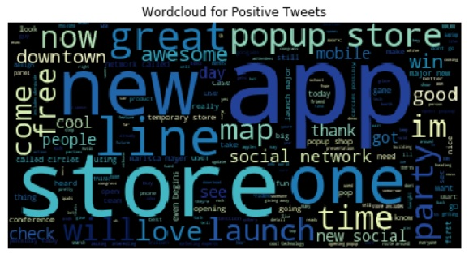
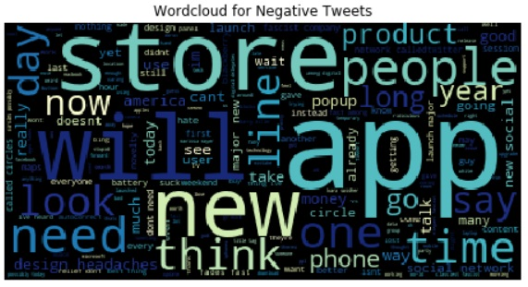
Wordclouds
There is some overlap in some words
There are more positive words (i.e. great) in the positive tweets
The positive tweets seem to reference new products

Slide 6
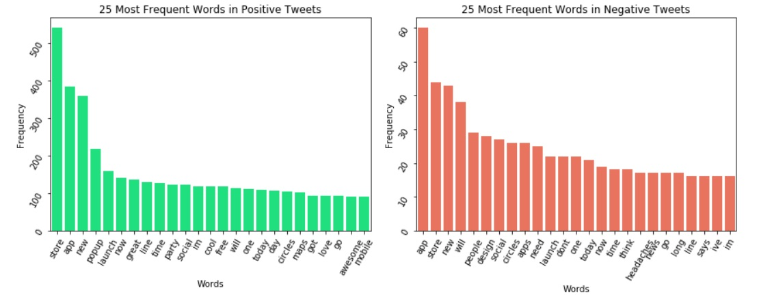
Most Common Words
Verbs appear more prominently in the negative tweets
There are multiple references to new products (i.e. popup, party) in the positive tweets
Overall the words are fairly similar, possibly related to where the tweets were collected

Slide 7
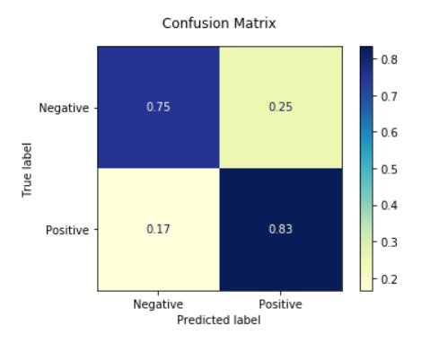
Modeling – Logistic Regression
Predicting the probability that an observation belongs to the negative class
Logistic regression is a fairly simple model
The best model was 82% accurate

Slide 8
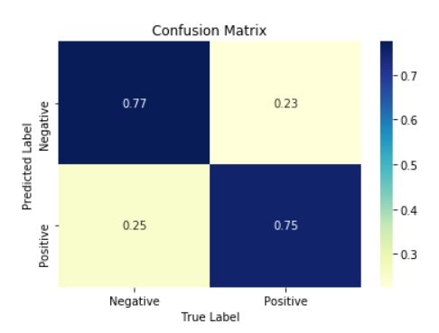
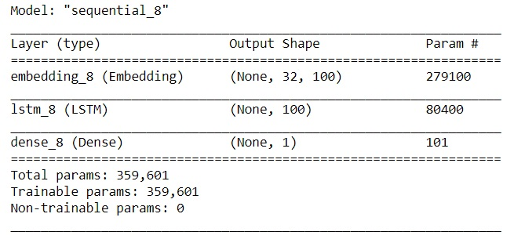
Modeling – Neural Networks
Long Short Term Memory neural networks
This is a network that is able to remember but also able to throw away information it does not need
The best model was approximately 75% accurate

Slide 9
Recommendations
More complex is not always better
Use a logistic regression model to classify tweets as positive or negative
Because the model only correctly classifies negative tweets 75% of the time and positive tweets 83% of the time, it is important to check the model against human verification
Tweets using this model should have urls, hashtags, and usernames removed

Slide 10
Future Work
Collect more data
Add in neutral category
Get data from a wider time period

Slide 11
Summary
People tended to tweet more positively about the excitement of new products
Action words, i.e. will, are more common in negative tweets, perhaps indicating that people are tweeting about their intention to stop using a product
While the current model has fairly good accuracy, steps can be taken to improve the classification
The logistic regression model outperforms the neural network model in classifying positive and negative tweets
This model is faster, more consistent, and requires fewer resources

Slide 12
Thank you!

